Slide 1
Introduction to Soft Computing
Course: Soft Computing​
Course Code: 22AIP3202
CO - 1
Session - 1

Slide 2




AIM OF THE SESSION
To introduce students about the Soft Computing
To familiarize students with the Concept of Computation
To introduce students about the hard Computing
To make students know about real world applications of soft computing
INSTRUCTIONAL OBJECTIVES
This unit is designed to:
Introduce computing concept
Demonstrate components of soft computing
Describe the examples of soft Computing
Understand the Fuzzy Logic System architecture
LEARNING OUTCOMES
At the end of this unit, you should be able to:
Define the functions of Soft Computing
Summarize the techniques used for Soft Computing
Describe the real-world applications of soft computing and Fuzzy Logic System Architecture.

Slide 3
Concept of Computation
Computing
Y=f(x)
Antecedent
Consequent
Control Action
Figure: Basic of Computing
y=f(x), f is a mapping function.
f is also called a formal method or an algorithm to solve a problem

Slide 4
Important characteristics of computing
Should provide precise solution.
Control action should be unambiguous and accurate.
Suitable for problem, which is easy to model mathematically.

Slide 5
Different Types of Computing
Types
Hard Computing [0 ,1]
Soft Computing [0.2, 0.7]
Notes:
5

Slide 6
Hard Computing
Before soft computing, there is a traditional approach used in computing which needs an accurately stated analytical model proposed by Dr. Lotfi Zadeh.
Hard computing is suitable for mathematical problems, although it might be used to solve real-world problems, it consumes a large amount of computation time and cost.
Applications of hard computing are mobile robot coordination and forecasting combinational problems.
If we want to solve the deterministic problems, we can use a hard computing approach. As the problem grows in size and complexity, the design search space also increases.
Characteristics:
Precise result is guaranteed,
Control action is unambiguous
Control action is formally defined(i.e. with mathematical model or algorithm)

Slide 7
Soft Computing
Human reasoning is predominantly approximated, qualitative, and “soft”.
Humans can effectively handle incomplete, imprecise, and fuzzy information in making intelligent decisions.
Soft computing deals with approximate models and gives solutions to complex real-world problems.
Soft computing is an approach that gives an impression on the human mind to reason and learns in an environment of uncertainty and impression. The soft computing is a collection of methodologies that aim to exploit the tolerance for imprecision and uncertainty to achieve tractability, robustness, and low solution cost.
Its principal constituents are fuzzy logic, neuro computing and probabilistic reasoning.
The role model for soft computing is the human mind.
Soft computing deals with imprecision, uncertainty, partial truth and approximation to achieve close resemblance with human decisions.

Slide 8
Components of soft computing
Fuzzy Logic (FL)
Probabilistic Reasoning
Neural Network (NN)
Evolutionary Computation( based on the origin of species)
Genetic Algorithms(GA)
Swarm Intelligence
Fuzzy logic, probability theory, neural networks, and genetic algorithms are cooperatively used in soft computing for knowledge representation and for mimicking the reasoning and decision-making processes of a human.

Slide 9
Examples
Consider a problem where a string w1 is “uvw” and string w2 is “uvx”.
Problem-1 : Tell that whether w1 is the same as w2 or not?
Solution – The answer is simply No, it means there is an algorithm by which we can analyze it.
Problem-2 : Tell how much these two strings are similar?
Solution – The answer from conventional computing is either YES or NO. But these maybe 80% similar, this can be answered only by Soft Computing.

Slide 10
Need of Soft Computing
When conventional computing or analytical models does not provide a solution to some real-world problems. In that case, we require other technique like soft computing to obtain an approximate solution.
Hard computing is used for solving mathematical problems that need a precise answer. It fails to provide solutions for some real-life problems. Thereby for real-life problems whose precise solution does not exist, soft computing helps.
When conventional mathematical and analytical models fail, soft computing helps, e.g., You can map even the human mind using soft computing.
Analytical models can be used for solving mathematical problems and valid for ideal cases. But the real-world problems do not have an ideal case; these exist in a non-ideal environment.
Soft computing is not only limited to theory; it also gives insights into real-life problems.
Like all the above reasons, Soft computing helps to map the human mind, which cannot be possible with conventional mathematical and analytical models.

Slide 11
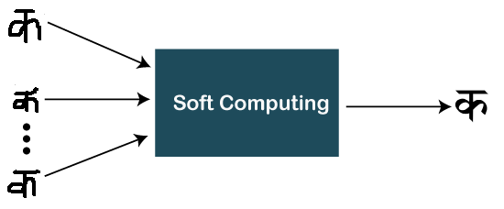
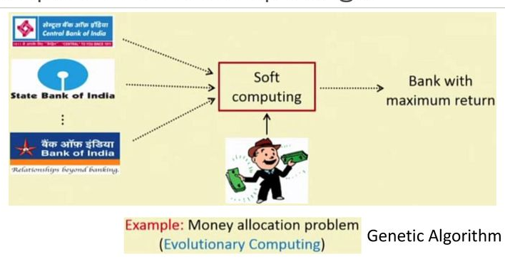
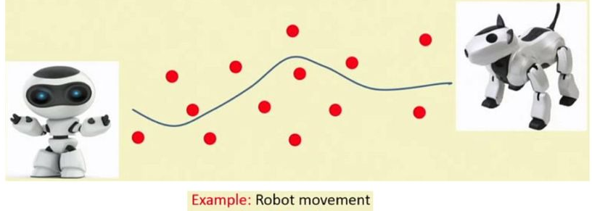
Examples of Soft Computing
Source: NPTEL

Slide 12
More applications of Soft Computing
In kitchen appliances, such as Microwave and Rice cooker.
In most used home appliances - Washing Machine, Heater, Refrigerator, and AC as well.
Apart from all these usages, it is also used in Robotics work (Emotional per Robot form).
Image processing and Data compression are also popular applications of soft computing.
Used for handwriting recognition.

Slide 13
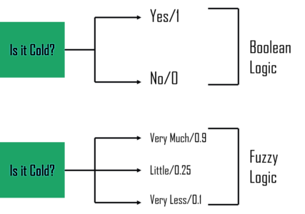
Boolean logic vs Fuzzy logic

Slide 14
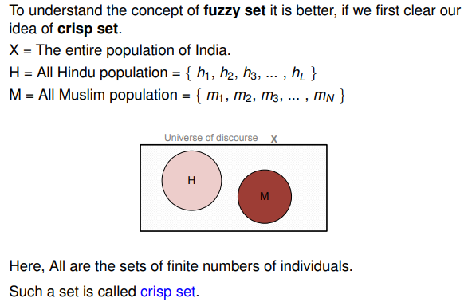
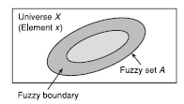
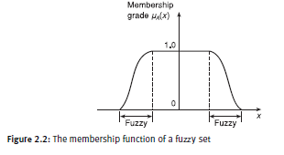
Illustration of types
Crisp Set
Fuzzy Set
Notes:
14

Slide 15
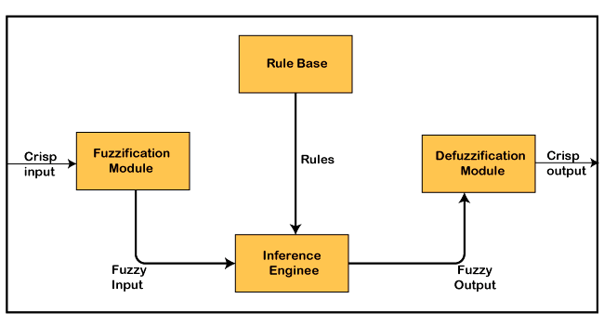
Fuzzy Logic System
1. Fuzzification module: Responsible for converting the crisp input values into fuzzy sets, which represent the degree of membership of the input values to each of the input variables. This is typically done using membership functions, which map the input values to a range between 0 and 1, representing the degree of membership.
2. Inference engine: It is the core of the fuzzy system. The inference engine typically consists of a set of fuzzy rules, which relate the input variables to the output variables. Each fuzzy rule is expressed in the form of an "if-then" statement, where the antecedent (if-part) of the rule specifies the conditions under which the rule is applicable, and the consequent (then-part) specifies the output values for each output variable.
3. Defuzzification module: Once the fuzzy output sets have been determined by the inference engine, the defuzzification module converts them back into crisp output values. This is typically done using a method called centroid defuzzification.

Slide 16
Fuzzy Logic System
Rule Base: fuzzy system also include other modules such as rule base, rule editor, and rule interpreter for managing and interpreting the fuzzy rules. The system may also include a learning module that can adjust the parameters of the membership functions and fuzzy rules based on training data, improving the performance of the system over time.
3

Slide 17
Membership function
Fuzzy set represented by a membership function [μA(x)] – defines grade (degree) of membership (possibility (possibility function) )
Properties
maps each element x of the universe[X] to value [0, 1]
μA(x): X → [0, 1]
randomness describes the uncertainty in occurrence of event
A = {(x, μA(x)); x ∈X, μA(x) ∈[0, 1]}
Fuzziness describes the ambiguity of an event

Slide 18
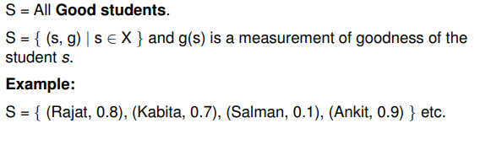
Example

Slide 19
Summary
Soft computing uses the techniques that can deal with uncertain, imprecise, and incomplete data. Unlike traditional computing methods, which are based on rigid rules and logic, soft computing techniques are designed to work with incomplete or uncertain information and to provide approximate solutions.
The three main components of soft computing are fuzzy logic, neural networks, and genetic algorithms.
soft computing provides a powerful set of tools for dealing with the complexities and uncertainties of real-world problems, and has the potential to lead to breakthroughs in a wide range of fields.
Fuzzy logic is a mathematical framework for dealing with uncertainty and imprecision. Unlike classical logic, which assumes that everything is either true or false, fuzzy logic allows for degrees of truthfulness between 0 and 1.

Slide 20
Self-Assessment Questions
Choose the absorption law in fuzzy sets
A ∩ B = B ∩ A
(A ∩ B) ∩ C = A ∩ (B ∩ C )
A ∪ (A ∩ B) = A
Which is not a fuzzy operation
Union
Intersection
convolution
3. A Fuzzy logic is an extension to the Crisp set, which handles the Partial Truth.
True
False

Slide 21
Self-Assessment Questions
Which of the following represents the values of set membership?
Degree of truth
Probabilities
Discrete set
Both a & b
Where can we use the Bayes rule?
To increase the complexity.
To decrease the complexity.
To solve queries
To answer the probabilistic query
3. JADEH coined the term soft computing in 1992.
True
False

Slide 22
TERMINAL QUESTIONS
Define soft computing.
What is computing?
Difference between hard and soft computing
Describe Fuzzy logic.
List out fuzzy system components
Analyze the set ={0/2 , 0.2/5 , 0.5/7 , 0.8/9 } and justify its crisp or not
Summarize the necessity of fuzzy logic.

Slide 23
THANK YOU

